Slide 1
Infection Prevention and Control- Southwestern Ontario (IPAC-SWO) Submission for 3M Chapter Achievement Award 2020

Slide 2
IPAC Southwestern Ontario: Looking Back – Looking Forward
Image: https://www.nojitter.com/unified-communications/looking-back-2020s-biggest-uc-tech-predictions

Slide 3
IPAC SWO Purpose:
To reduce the risk of infection across the care continuum through knowledge exchange,
To share experiences, ideas and information for the prevention and control of infections, and
To collaborate and network among persons interested in infection prevention and control (IPAC).

Slide 4
Objectives of IPAC SWO Chapter
To promote and enhance IPAC expertise through individual and group activities within South Western Ontario (SWO).
To assist individual members in the development of their own IPAC program within SWO.
To hold multi-disciplinary educational conferences or seminars to update knowledge in IPAC.
To support and assist with research/study activities and the publication of results.
To identify and compile IPAC measures that have proven effective in specific areas of concern, including evidence-based practice guidelines, recommendations, position statements, etc. that maintain safe, effective and quality care.
To promote communication with members across the continuum of care.
To assist individual members in their professional development in the field of IPAC.
To promote community awareness and understanding of the source of infection, the mode of transmission, and the means of control.
To act as an advocate for and increase awareness of IPAC practices and issues.

Slide 5
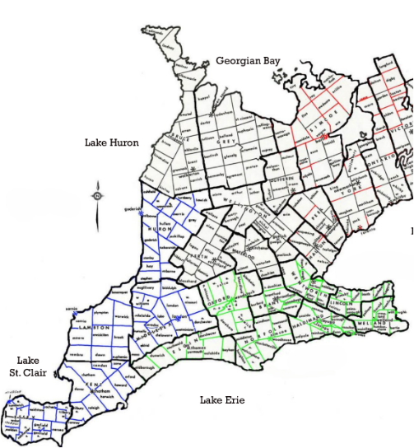
The Region of IPAC SWO
Southwestern Ontario is a secondary region of Southern Ontario in the province of Ontario.
With IPAC HUPIC to our north, IPAC SWO is bounded by the St. Clair River, Lake St. Clair, and Detroit River, to the west; and by Lake Erie to the south.
To the east, on land, Southwestern Ontario is bounded by Central Ontario and the Golden Horseshoe.
Central to our area is London Ontario, with a population of 395 295.

Slide 6
IPAC SWO - 39 and holding! Where we came from?
In 1969, four hospitals formed a network called the Southwestern Ontario Exchange Meeting Program.
In April of 1981, the network achieved chapter status and was called the Southwestern Ontario Practitioners in Infection Control (SOPIC). At that time, there were 40 members of the chapter.
The name of the chapter has changed from SOPIC in 1981 to CHICA-SWO in 2008 and finally to Infection Prevention and Control- Southwestern Ontario (IPAC-SWO) in 2014.

Slide 7
Scope of IPAC SWO Membership
105 Individual and 19 Institutional memberships
4th highest chapter membership across the country
Multi-discipline Membership: ICPs, Program Managers, Public Health Inspectors and Nurses, Environmental Services, Consultants, Occupational Health, Educators, IPAC Specialists, Medical Lab Technologists, Students, Physicians, and Industry
Top Representation: Acute Care 45.8%, Public Health 24.5%, Industry 14.7%, Government 6.5% , LTC 8.5%

Slide 8
2020 IPAC SWO Executive
President: Dori Taylor, RN, BScN, CIC, CCHN(C)
Past - President: Francine Paquette, BASc, CPHI(C), CIC
Treasurer/Membership: Sonalben Shah, MSc, CIC
Secretary: Robyn Latendresse, RN, BScN
Education Co-Chairs:
Kim Hobbs, RN, BScN, CIC and Lindsay Samoila, RN, BScN, CIC
Knowledge Transfer: Shelby Ludington, BAH
Webmaster: Eleanor Paget, RN, BScN, CIC
Non-acute Care Representative: Cara-Lee Coghill, RN, MScN, CCHC(C)
Representatives from Public Health and Acute Care
Members range from 3-8 years service on the IPAC SWO Executive by 2022
Unique to executive structure - Knowledge Transfer position

Slide 9
IPAC SWO Membership Representation in IPAC Canada Committees and Interest Groups
Elaine Reddick – Dialysis Interest Group, Environmental Hygiene Interest Group
Kim Hobbs – Education Committee, Healthcare Facility Design & Construction, Network of Networks
Jean Clark– LTC Interest Group, Community Healthcare Interest Group
Dori Taylor – Education Committee, Oncology Interest Group
Scott Rutherford – Pre-hospital & First Responders Group
Lorna Morgan, Laura Farrell – Reprocessing Interest Group
Francine Paquette – Surveillance/Applied Epidemiology Interest Group, Environmental Hygiene Interest Group
Cara-Lee Coghill – Standards and Guidelines Committee, Pediatrics and Neonatal Interest Group
Lindsay Samoila – Mental Health Interest Group
Sonalben Shah – Membership Committee
Joanne Dow – IPAC Chapter Council Representative – Central West Region

Slide 10
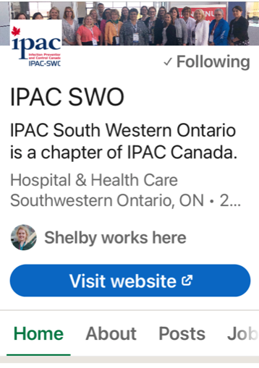
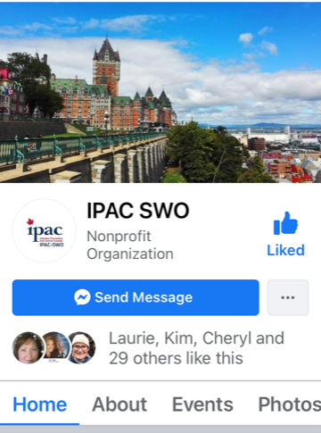
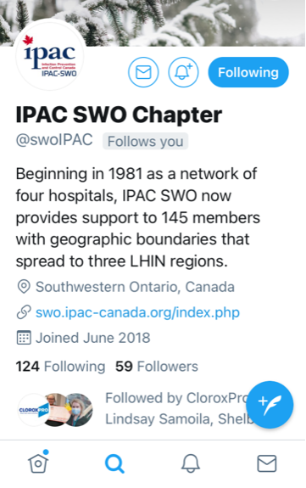
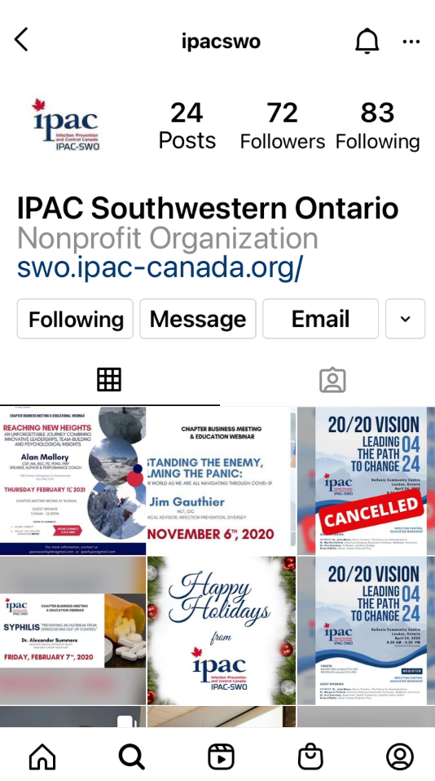
IPAC SWO Shines on Social Media
Social Media presence established in 2018 on Facebook, Instagram, LinkedIn and Twitter
All interfaces link to IPAC SWO website for easy access

Slide 11
Expanding the Use of Technology
Seamless registration and check-ins made possible through use of Eventbrite for registrants, speakers and vendors alike!
All communication to and from Members conducted through IPAC SWO generic Gmail account.
Redesign of IPAC SWO website including outward public facing and inward member only facing secure access.

Slide 12
2020 Chapter Education Committee
Education Co-Chairs: Kim Hobbs, Woodstock Hospital and
Lindsay Samoila, Hotel Dieu Grace Health Care
Education Committee Members:
Joanne Dow, Middlesex London Health Unit
Sonalben Shah, Woodstock Hospital
Sarah Cowan, Elgin-St. Thomas Hospital
Jessica Kooger, Elgin-St. Thomas Hospital
Jean Clark, Revera Living
Robin Latendresse, Southwestern Public Health
Francine Paquette, peopleCare Communities
Eleanor Paget, IPAC West, Public Health Ontario
Cheryl Tung, Middlesex London Health Unit
Dori Taylor, Huron-Perth Health Unit

Slide 13
2020 Chapter Meeting and Education Days
Three chapter meetings, two of which also had education webinars were offered: February 7th, September 18th,and November 6th
Topic areas for the education portion are carefully chosen to ensure applicability across diverse healthcare sectors:
Goals:
To broaden the scope of Infection Prevention and Control to be representative of all health care sectors,
To provide IPAC SWO Chapter updates to Membership and highlight the benefits of membership to guest/non-members at every event and opportunity
To offer education to support the achievement of IPUs for CIC recertification
Notes:
Feb, April, June, Sept, Nov

Slide 14
2020 Education Webinars

Slide 15
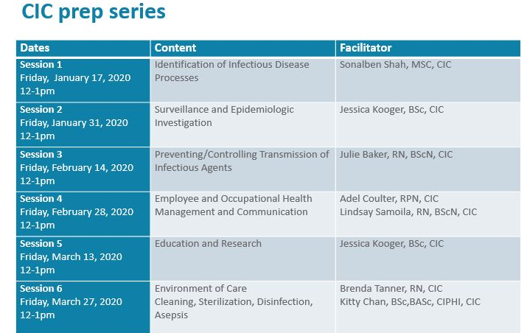
Supporting Our Members: Certification - CIC Prep Series
Offered in partnership with IPAC HUPIC and the IPAC West Regional office, Public Health Ontario
All facilitators were members of IPAC Canada
36 members participated the six-session series
Primary focus was on support and networking in preparing for the CIC exam

Slide 16
IPAC SWO Gives Back
Financial Donations from IPAC SWO included:
IPAC Canada President's Fund 2020

Slide 17
IPAC SWO Planning Ahead!
Continuing to focus on quality education offerings on topics that are applicable across the health care sectors with promotion of participation from both members and non-members.
Planning four webinars scheduled for February, June, September and November.

Slide 18
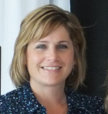
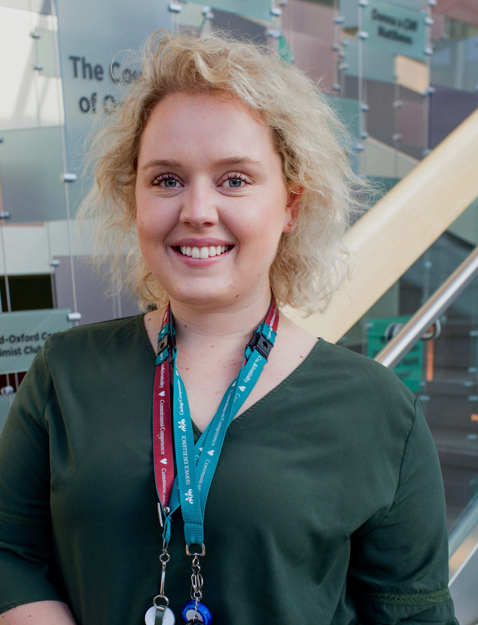
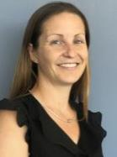
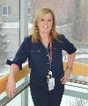
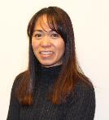
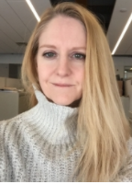
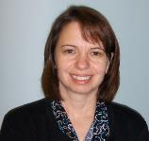
Celebrating 2020 from the dedicated executive of IPAC SWO!

Slide 19
Through the most challenging of times, IPAC SWO continues to celebrate the individuals who comprise the membership of this chapter and their facilities who continue to support their participation in the work of the chapter! We thank them for their time, energy and dedication to the on-going success and vitality of IPAC SWO and acknowledge the challenges that they faced and over came in 2020!

