Slide 1
Surveillance of Infections in
Long-Term Care
Training Presentation
Notes:
LTC Surveillance Toolkit Training Slides
This purpose of this slide deck is to introduce frontline staff to surveillance, what is and why it is important in the LTC setting, and their role in the facility’s surveillance program.

Slide 2
Objectives
To understand what surveillance is and why it’s important
Data collection
How to use the daily surveillance form
What happens next?
Notes:
The objectives of this presentation include developing a basic understanding of what surveillance is, why we do it and why it’s important. We will also review what the expectations of you are and we can discuss how this process is different from the process you are used to. It’s important to remember that we have always done surveillance in some form, this is just a slightly different and more standardized approach. We will also review the daily surveillance form, and what happens once that form is completed and collected.

Slide 3
Surveillance
What is surveillance?
Systematic ongoing collection, collation and analysis of data
Shared with those who can take action in a timely manner
Surveillance can reduce infections by:
Identifying increasing trends of infections to allow for early interventions
Preventing health care-associated infections (HAIs)
Preventing outbreaks
Identifying outbreaks early
Improved awareness of signs/symptoms of infections
Notes:
What is Surveillance? Surveillance is the ongoing collection, collation and analysis of data. It’s important that the data be used for a purpose and should be shared, in a timely manner, with people who can take action and do something with the information. For example, if a home were to see a sudden increase in one type of infection, the information should be shared with people who can start to investigate the cause and develop a plan to reduce the number of cases.
One of the reasons we do infectious disease surveillance is because it can reduce the number of infections in our residents. We can identify trends of infections quickly and if we see an increase, we can put in interventions that can reduce or stop transmission. This can prevent health care-associated infections and even prevent outbreaks. Surveillance also increases the awareness of the signs and symptoms of infections in general.

Slide 4
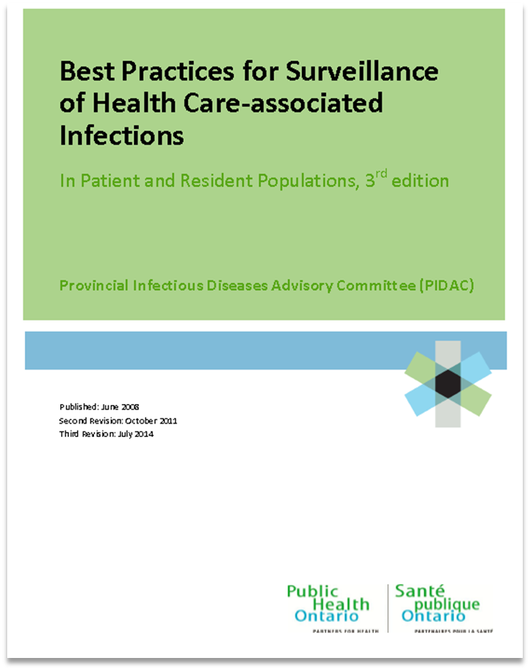
Surveillance Best Practice Document
Great resource to learn more about surveillance:
https://www.publichealthontario.ca/-/media/documents/bp-hai-surveillance.pdf?la=en
Notes:
If anyone is ever interested in reading more about surveillance, this document was created by the Provincial Infectious Disease Advisory Committee in Ontario and is a great resource to learn the basics of surveillance – how it’s done and why it’s important. It’s available on the Public Health Ontario website.
https://www.publichealthontario.ca/-/media/documents/bp-hai-surveillance.pdf?la=en

Slide 5
Why is Surveillance Important in LTC?
Health care-associated infections are common in long-term care (LTC)
3-7 cases per 1000 resident days
Outbreaks can be difficult to contain
Outbreaks result in significant cost to the organization
It is estimated that 70% of HAIs are preventable
The population requiring LTC is increasing and are at greater risk for infections
Have other underlying health conditions
Receive more medical care and procedures
HAIs are the most frequent cause of transfers to hospital
Notes:
Surveillance is important in all health care settings but why specifically is it so important in long-term care settings? We know health care-associated infections are common in LTC with 3-7 cases of health care associated infections occurring per 1000 resident days. As everyone knows, outbreaks can be difficult to contain, they put the residents at risk, are a lot of work and result in a significant cost to the organization. It is estimated that up to 70% of health care associated infections are actually preventable with surveillance and strong infection control practices.
The population of Ontario requiring LTC is increasing as time goes on and this population is also at a greater risk of infections and a greater risk of serious outcomes when infections occur. LTC residents often have underlying health conditions and receive more medical care making them at an increased risk of infections. Health care-associated infections are also the most common cause of transfers to hospitals. Performing consistent and accurate surveillance in long-term care home settings is critically important for a variety of reason.

Slide 6
Implementation of a Surveillance Program
The LTC Surveillance Toolkit was developed by PHO IPAC specialists in collaboration with Schlegel Villages to support LTC infection control staff in tracking and controlling infections
The toolkit was trialed in Schlegel Villages LTC homes, evaluated and improved
Notes:
A toolkit, consisting of various forms and worksheets to perform surveillance, was created in a collaborative effort between Public Health Ontario (PHO) infection prevention and control specialists along with Schlegel Villages long-term care homes in Ontario. The toolkit was trialed in Schlegel Villages homes and after a year an evaluation was conducted and improvements to the form were made.

Slide 7
What does this mean for you?
New data collection form will be introduced
The daily surveillance form is used to capture signs and symptoms of infections in residents on every shift
Sign the daily surveillance form every shift
Enter progress notes into resident charts
The Infection Control Professional (ICP), or designate, will regularly (daily/weekly) review daily surveillance form and collect/keep at the end of the month
Notes:
What exactly does all of this mean for you? A new data collection tool, the daily surveillance form, will be introduced. You must make sure that all signs and symptoms of infections are being captured on every shift. You must initial in the appropriate box to confirm that you did monitor the residents and completed the form. You definitely want to make sure you are completing your progress notes as well. The daily surveillance form does not take the place of progress notes in the resident’s chart. The ICP will regularly review the daily surveillance form, collect the form at the end of the month and then proceed with entering the data into a different form that will be used for analysis, creating graphs and looking at trends over time.

Slide 8
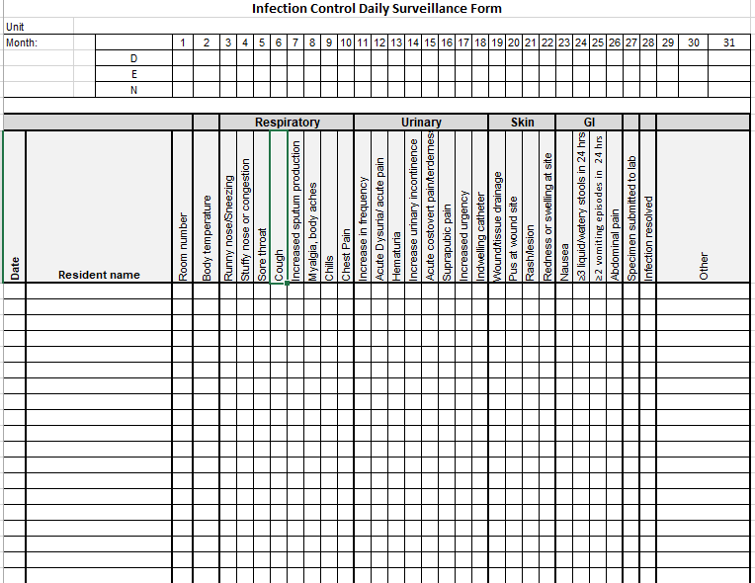
Daily Surveillance Form
Notes:
This is the daily surveillance form. You want to make sure you are checking off all of the signs and symptoms as accurately as possible. Common signs and symptoms of infections are listed and are grouped by infection type. There may be additional signs/symptoms of infection noted in your residents and these can be added to the ‘other’ column. More detailed charting must be entered into the progress notes. This form is not intended to replace the progress notes but instead be used as a communication tool so nursing staff are aware of which residents are under observations for infections from shift to shift and as a way to communicate with the infection control professional about which residents need to be reviewed to identify cases of infections.

Slide 9
Daily Surveillance Form
Place one of these forms on each unit
Used by front line nurses to document signs and symptoms of infections
Responsible nurse initial each shift
Doesn’t replace complete documentation in progress notes
Notes:
This is just a closer look at the top of the daily surveillance form. Here is where the unit and month will be written on to the form. A new daily surveillance form should be used at the beginning of each month and when all the lines of this form are used. The form needs to be initialed on every shift to indicate the information on the form has been reviewed and is accurate. Again, this isn’t intended to replace progress notes. Progress notes still need to be made.

Slide 10
Daily Surveillance Form
Nurses enter date, resident name showing signs/ symptoms of infection and the room number
Body temperature is entered as a number (e.g. 40.2°C)
Indicate all signs/symptoms that the resident develops
Notes:
Here is an example of how you would fill out this form and this can be hand written in as you will have paper copies of this form on the units. Enter the day the signs or symptoms of infection started. The resident name and numerical fever temperature should be entered onto the form. Any signs or symptoms of infection the residents begins to experience can be indicated with an X. The same line can be used if the resident develops new signs/symptoms related to the same infection over time.

Slide 11
Case Definitions
Must record all signs and symptoms accurately because cases will be based on case definitions
Specific definitions for fever
single oral temperature >37.8° C OR
repeated oral temperatures >37.2°C or rectal temperatures >37.5°C OR
single temperature >1.1°C over baseline from any site (oral, tympanic, axillar)
Notes:
One of the reasons why it’s so important to make sure all of the symptoms are documented accurately and completely, is because once a resident has been identified as having a potential infection, they will be assessed to determine whether or not they meet the case definitions for that particular type of infection. A resident may have one or two signs of an infection but may not actually meet the case definition and therefore wouldn’t be counted in the total counts of infection. The case definitions are quite detailed so it’s important to be as accurate as possible. One example of the level of detail that is required is with respect to fever. Just indicating a resident is febrile isn’t sufficient rather the actual temperature is required because there is a specific definition of fever as shown in this slide. Greater than 37.8 may be a fever OR repeated oral temperatures greater than 37.2 or rectal temperatures greater than 37.5 degrees Celsius.

Slide 12
Case Definitions
Notes:
Just to give you an example of what the case definitions looks like, this is the case definition for urinary tract infection. There are 2 different definitions depending on whether or not the resident has an indwelling catheter. You can see that quite a few signs and symptoms PLUS laboratory results go into determining whether or not the resident has a UTI. You will also notice that prescription of antibiotics is not a part of this definition so you might see doctors prescribing antibiotics for cases that don’t meet the case definition. These definitions are applied by the ICPs, it isn’t something you have to worry about doing but we just wanted to illustrate why it’s so important to be accurate with your observations of signs and symptoms of infections.

Slide 13
The Process
Monitor residents for signs and symptoms of infections on every shift
Record signs and symptoms of infections on daily surveillance form
Initial daily surveillance form each shift
ICP will regularly review the forms for completeness and will collect at the end of the month
Data gets entered into a surveillance reporting form
Cases are validated using case definitions
Rates of infections are calculated
Will be able to identify trends for infections
Compare infections rates to own LTCH and to other LTCHs
Notes:
The process of surveillance basically just involves you monitoring your residents for signs and symptoms of infection on every shift and making sure you complete the daily surveillance form. Once you have done that, the ICP will take the form, review for completeness and then will perform the rest of the surveillance. All of the data plus information taken from the progress notes, laboratory results and diagnostic imaging results will get entered into another form, the surveillance reporting form. The ICP will also apply case definitions to confirm that what is being counted as a case in the reporting form, does actually meet the case definition. Once all of the information has been entered, rates will be calculated for the month and compared to the rates of other months. Graphs will be created to be able to visualize the data and to share it.

