Slide 1
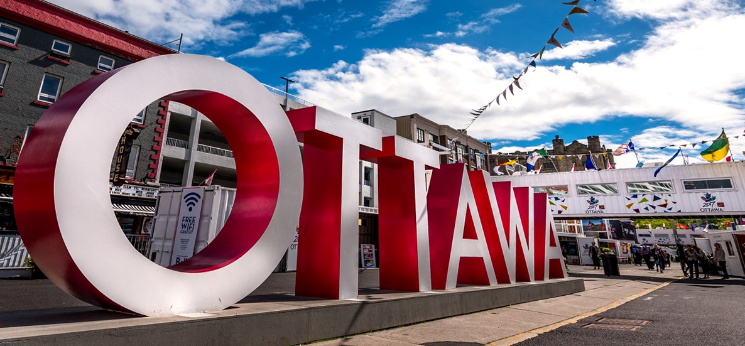
IPAC Ottawa Region
Reflections from 2017… Wow, what a year!
http://www.ottawa2017.ca/events/signature-events/inspiration-village/

Slide 2
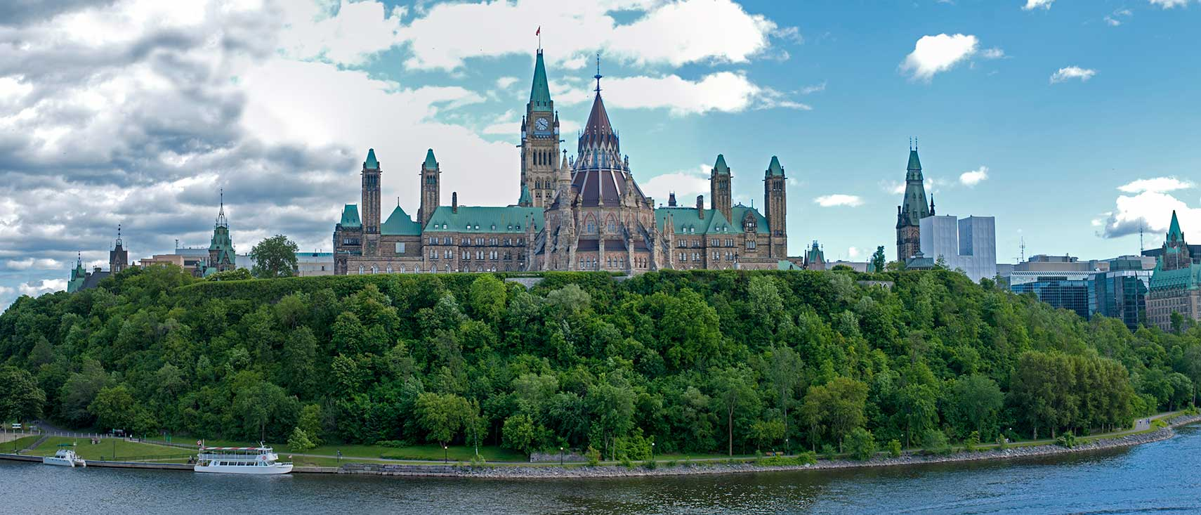
Membership from Ottawa and surrounding area, east to the Quebec border
http://www.nationsonline.org/oneworld/map/google_map_Ottawa.htm

Slide 3
History
1984 members from across the Ottawa region came together as “Ottawa Organization for Practitioners in Infection Control”
2009- changed name to CHICA Ottawa Region
2014- changed name to IPAC Ottawa Region

Slide 4
IPAC OR Executive 2017
President
Sam MacFarlane RN, CIC
President Elect
Jo-Anne Janigan RN BScN CIC
Secretary
Shelley Hudson RN BScN
Treasurer
Claude Bussière I.A, RN
Education Coordinators
Donna M. Perron RN, BScN, CIC and Caroline Meguerditchian, CIC
Membership Director/Social Media
Annie Lord-Stephens RN, CIC
Webmaster
Pat Bedard, RN, CIC

Slide 5
IPAC OR Mission and Vision
Mission:
IPAC OR is a regional multidisciplinary professional association committed to the wellness and safety of Canadians by promoting best practices in infection prevention and control through education, standards, advocacy and consumer awareness.
Vision:
IPAC OR will be a regional leader and recognized resource for the promotion of best practice in infection prevention and control

Slide 6
IPAC OR Objectives/Goals
To provide a forum for professionals in IPAC and other allied professionals in healthcare to network and share ideas from the full continuum of healthcare (acute and long-term care, community and homecare)
To share knowledge and expertise with healthcare workers to decrease the incidence of healthcare associated and community acquired infections
To advance professional excellence through continuing education

Slide 7
IPAC OR Objectives/Goals
To enhance the practice of IPAC by advocating for certification among chapter members
To foster research activities and support the publication of results by chapter members
To promote IPAC OR and its members as regional experts in IPAC
To promote/champion/further IPAC Canada as the national body of experts in IPAC

Slide 8
Keeping our members connected
Twitter
Facebook
IPAC OR web page

Slide 9
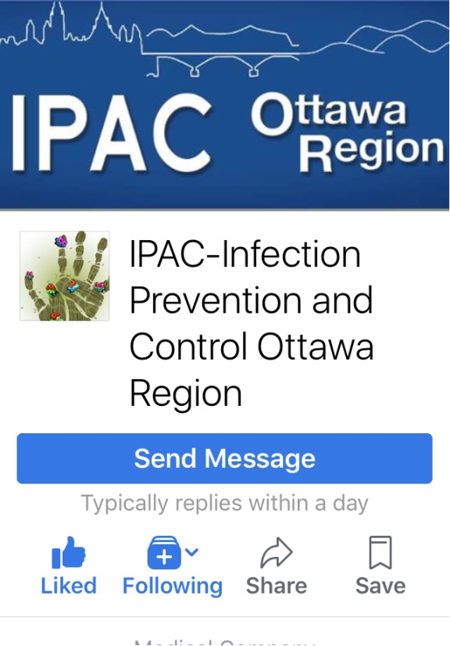
Keeping our members connected
Our Facebook account

Slide 10
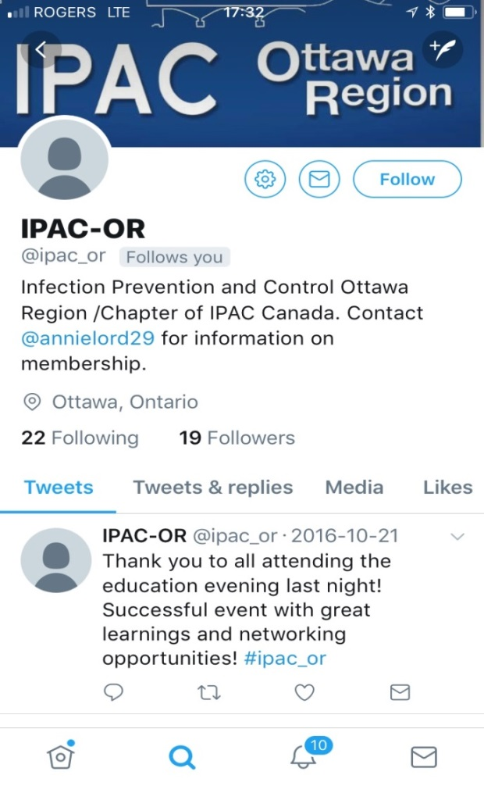
Keeping our members connected
Our Twitter account

Slide 11
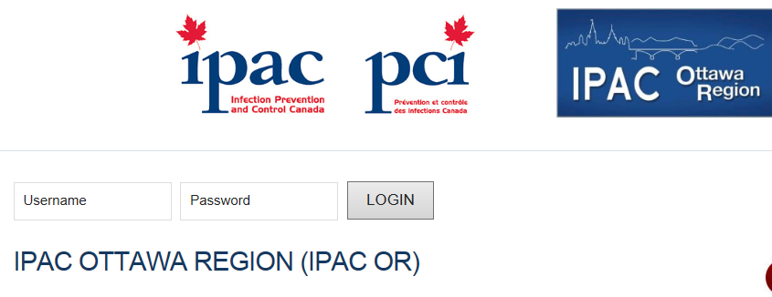
Keeping our members connected
Our webpage

Slide 12
Keeping our members connected
IPAC OR meetings:
The membership meets 5 times a year, and IPAC OR uses a blended approach, Adobe platform and face to face for meetings
Members can choose to participate in the entire meeting or just portions of it (i.e. to provide updates on their interest groups; listen into the education portion of the meeting)
The IPAC OR executive is committed to extending the invitation for chapter meeting education sessions to chapters across Ontario, assuming the topic would be of provincial interest.
During 2017 we extended invitation for our all of chapter meeting to IPAC Renfrew, IPAC Eastern Ontario and IPAC Quebec

Slide 13
Achievements
Our members

Slide 14
Facts about our membership
We have an average of 90 IPAC OR members
We have an average of 20-30 in person members at our chapter meetings with many more participating virtually

Slide 15
Facts about our membership
Diversity of our membership
  Representation from EMS, labs, Community, Mental health, Long-term care, Acute Care, Midwifery, Community Hospitals, Two Public Health units, Provincial Partners (Public Health Ontario), Canadian Military, Public Health Agency of Canada, ICP from Hemodialysis setting, ICPs from Cardiac Facilities (The Heart Institute), Vendors, ICP from Nunavit

Slide 16
Supporting Certification
Study groups
Pinning ceremony

Slide 17
CIC Study Group
2017 was the second year that IPAC OR facilitated CIC study
7 CIC study group sessions
Active participation from members
Speakers drawn from the expertise within IPAC Ottawa Region
Option for teleconferencing and in-person
You didn’t have to write in order to participate
You didn’t have to come to all of the sessions

Slide 18
CIC Study Group
October 10, 2017
  Susan Cooper- Identification of Infectious Disease Processes
November 1, 2017
  Lindsay Whitmore- Surveillance and Epidemiology
November 16, 2017
  Jo-Anne Janigan- SSI surveillance
  Colleen Weir- Dialysis surveillance
November 29, 2017
  Catherine Richard- Occupation Health and Safety
  Josee Shymanski- Management and communication

Slide 19
CIC Study Group
January 17, 2018
Donna Perron- Reprocessing
January 31, 2018
Claude Bussiere- Construction and Renovation
February 14, 2018
Ryan MacDougall- Environmental cleaning and selection of products

Slide 20
CIC Pinning Ceremony
At our December meetings we have a “pinning ceremony” for newly certified CIC
IPAC OR buys the pins for the successful candidates
It’s an opportunity to celebrate a milestone in an ICPs career
It’s an opportunity for ICPs to share their study group experiences and their strategies in challenging the exam
It’s a time to discuss opportunities for ongoing CIC study group
In December 2017, 5 IPAC OR members were “pinned” and another member was pinned virtually, for a total of 6 new CICs
We had 7 members successfully complete their SARE

Slide 21
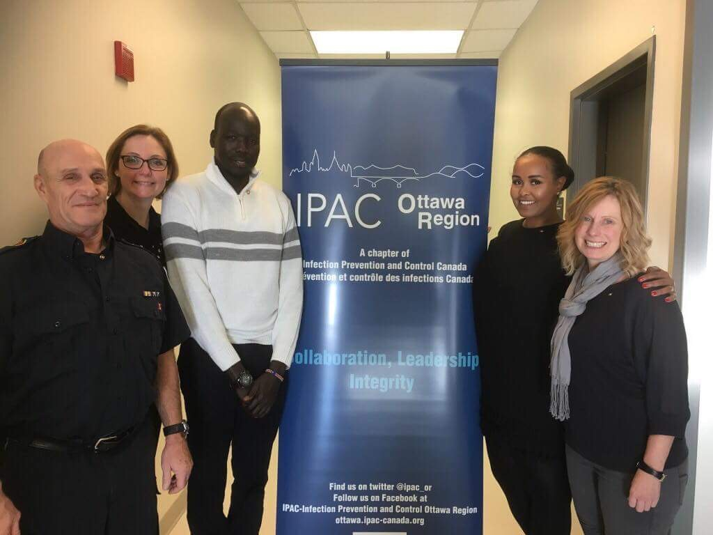
CIC Pinning Ceremony

Slide 22
Education
Education at our Chapter meetings
Education evening

Slide 23
Education at chapter meetings
February 9, 2017
Sam MacFarlane, presented-
ICRT: Lessons Learned From the First Five Years
Sam also shared results from published article “ Using expert Process to combat Clostridium difficile infections” American Journal of Infection Control, December 2016.
April 13, 2017
Valerie Yeung presented-
ASP Landscape Survey, The results are in!
This was an interactive and facilitated discussion regarding ASP and IPAC in healthcare facilities. Members answered questions which were posted around the room and debriefing/discussion about the answers followed.

Slide 24
Education at chapter meetings
June 8, 2017
Dr. Gary Garber presented-
Back to the Future- VRE- It’s Back
Of note: At this meeting ICPs and Physicians from IPAC Montreal called in and listen to the education session
October 19, 2017
Jo-Anne Janigan et al presented-
Highlights of the 2017 IPAC Canada Conference
Members that attend the national conference pay it forward by presenting on lessons learned/highlights for those members who could not attend the conference.
December 14, 2017
Erin Culley presented-
TB in the Marginalized Population
Erin spoke about real life challenges and opportunities of doing IPAC in marginalized populations

Slide 25
Education evening
Evening education/discussion on C diff
September 28, 2017

Slide 27
Education evening
Light dinner provided for attendees
Networking opportunities built into the dinner session
  80 participants attended the evening session
  Three guest speakers discussing current research into Clostridium difficile
Collaboration between IPAC OR, Public Health Ontario and Ottawa Public Health

Slide 28
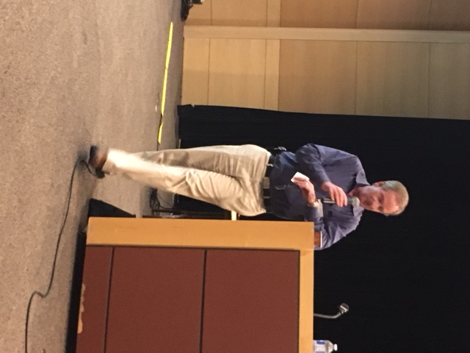
Speakers
Dr. Gary Garber
Chief, IPAC Department Public Health Ontario
“Introduction to the landscape of CDI”

Slide 29
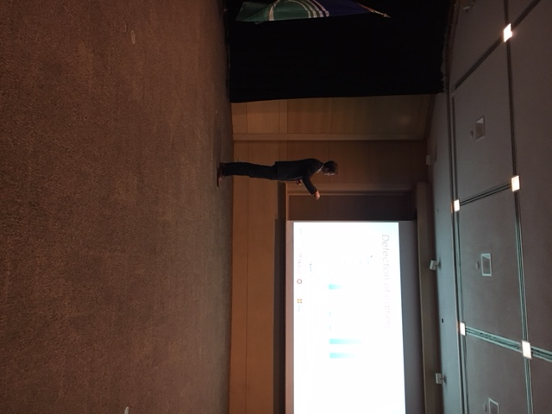
Speakers
Dr. Yves Longtin
Chair, Infection Prevention and Control Unit,
Jewish General Hospital
“Isolating C. difficile Asymptomatic Carriers- Containing what Lies under the Waterline”

Slide 30
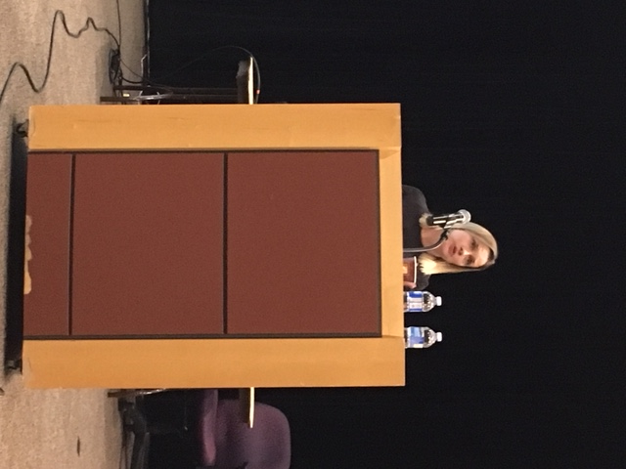
Speakers
Dr. Jenny Johnstone
IPAC Physician Public Health Ontario; Infectious Diseases and Infection Control, St. Joseph's Health Center, Toronto
“Clostridium difficile Colonization in Ontario (COLON): Acute Care Hospital Pilot Feasibility Study, Preliminary Findings “

Slide 31
Supporting our membership
Financial supports offered

Slide 32
Supporting our members
Reimbursement for CIC/SARE
  Reimbursement for 4 members who successfully challenged the CIC
Reimbursement for attendance at IPAC Canada conference
  Reimbursement for 4 members that attended the IPAC Canada 2017 conference in PEI

Slide 33
IPAC Canada Conference
11 members of IPAC OR attended the natational conference
4 were supported with financial reimbursement for registration fees
1 speaker, 2 posters from our IPAC OR chapter
Lots of networking done with other chapters from across Canada

Slide 34
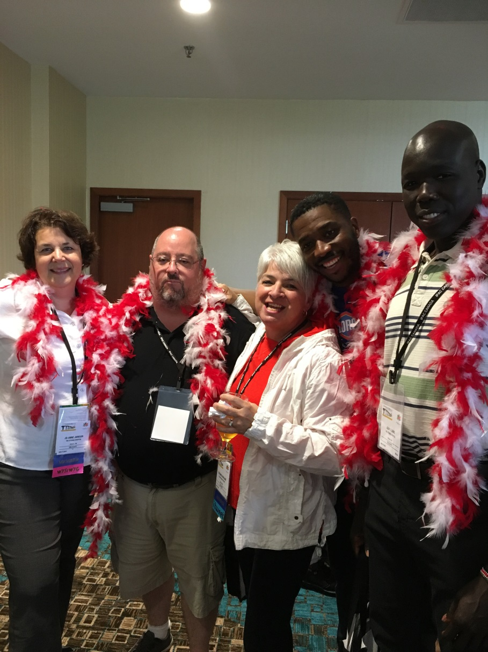
150 pride
Red and white boas brought to conference by IPAC Ottawa region… sharing not only our IPAC enthusiasm but our 150 enthusiasm

Slide 35
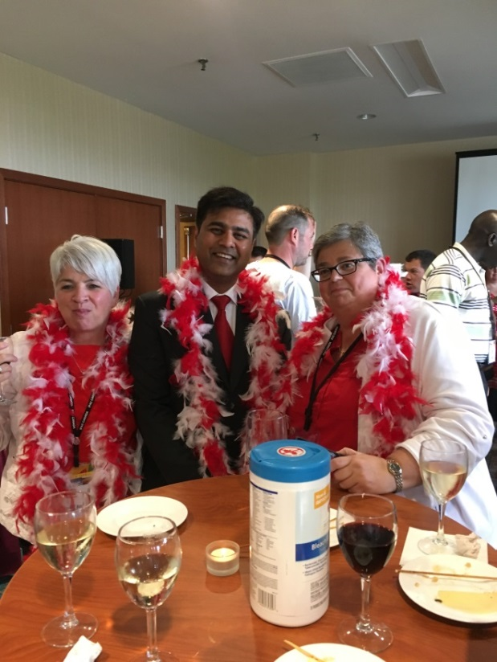
Networking with other IPAC Chapters
IPAC Ottawa Region seen here networking with IPAC GTA and IPAC Eastern Ontario

Slide 36

Team spirit at IPAC Canada conference

Slide 37
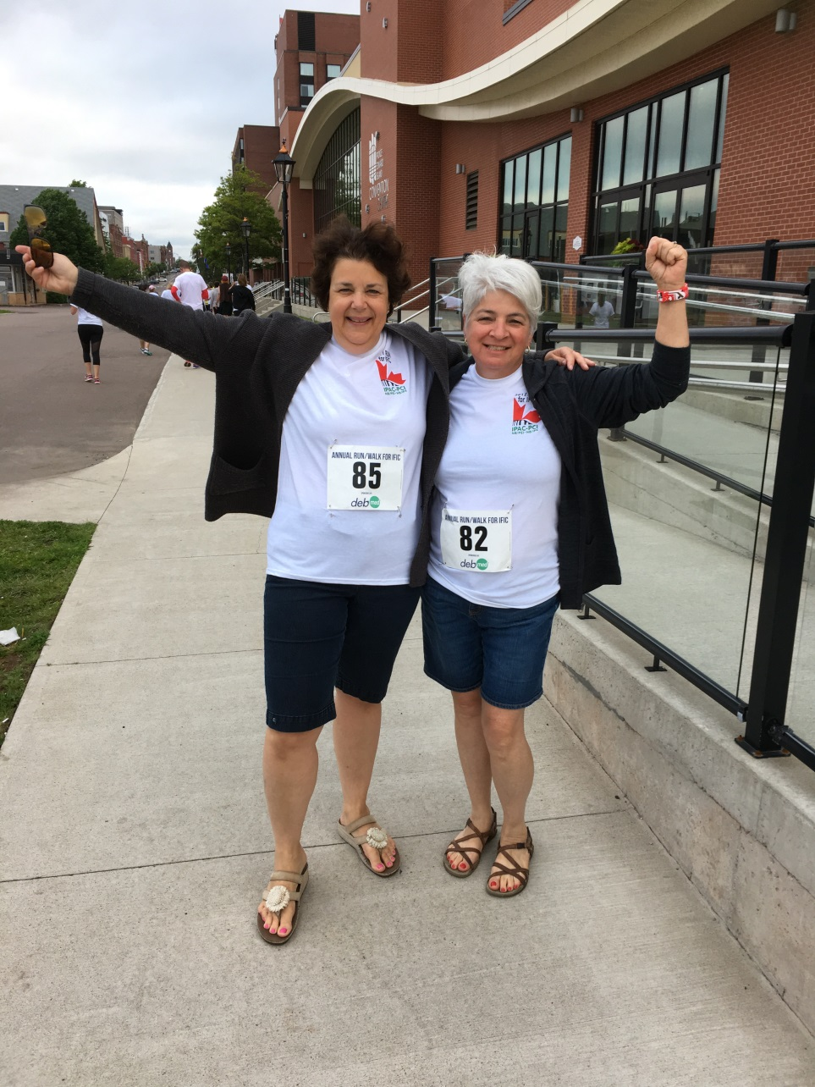
Participation at the IFIC Run

Slide 38
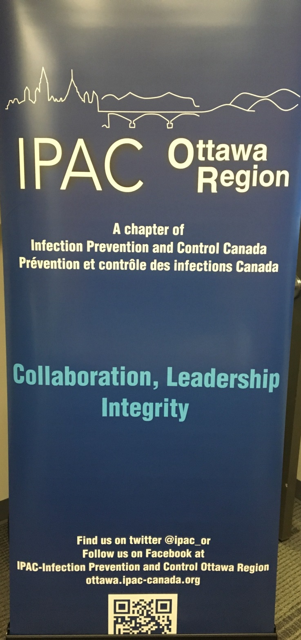
Advertising who we are: our IPAC Ottawa Region banner

Slide 39
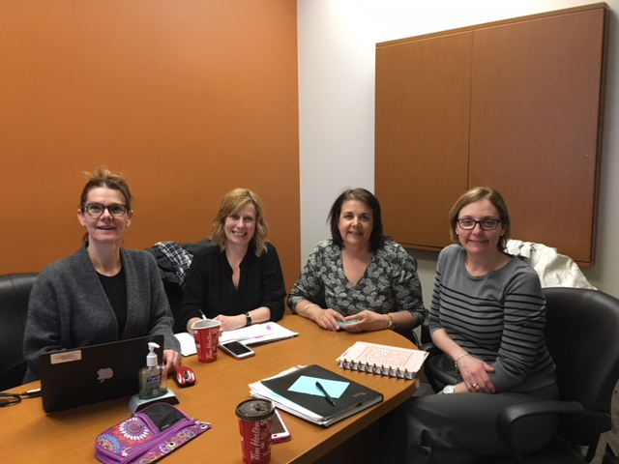
Thank you …..
The hardworking team that supported the creation of this submission :)
We are so proud of the hard work, enthusiasm and commitment of our IPAC OR Chapter!

